Slide 1
Database Systems
Lecture 2-Chapter # 20
Introduction to Transaction Processing Concepts and Theory
Alina Arshad
alina.arshad@nu.edu.pk

Slide 2
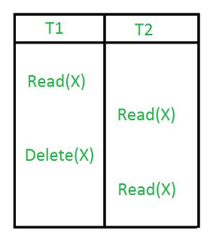
The Phantom/non repeatable Read Problem
Transaction T executes a query that retrieves a set of tuples from a relation satisfying a certain predicate
T re-executes the query at a later time, but finds that the retrieved set contains an additional (phantom) that has been inserted by another transaction in the meantime.
T receives different tuples for the same query
In the above example, once transaction 2 reads the variable X, transaction 1 deletes the variable X without transaction 2’s knowledge. Thus, when transaction 2 tries to read X, it is not able to do it.

Slide 3
Why Recovery is Needed
Committed transaction
Effect recorded permanently in the database
Aborted transaction
Does not affect the database
Types of transaction failures
Computer failure (system crash)
Transaction or system error
Local errors or exception conditions detected by the transaction
Concurrency control enforcement
Disk failure/Physical problems or catastrophes
System must keep sufficient information to recover quickly from the failure
Disk failure or other catastrophes have long recovery times

Slide 4
Transaction and System Concepts
System must keep track of when each transaction starts, terminates, commits, and/or aborts
BEGIN_TRANSACTION
READ or WRITE
END_TRANSACTION
COMMIT_TRANSACTION
ROLLBACK (or ABORT)

Slide 5
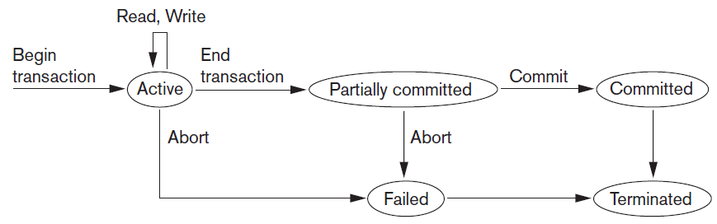
Transaction and System Concepts (cont’d.)
Figure 20.4 State transition diagram illustrating the states for transaction execution

Slide 6
The System Log
System log keeps track of transaction operations
Sequential, append-only file
Not affected by failure (except disk or catastrophic failure)
Log buffer
Main memory buffer
When full, appended to end of log file on disk
Log file is backed up periodically
Undo and redo operations based on log possible

Slide 7
Commit Point of a Transaction
Occurs when all operations that access the database have completed successfully
And effect of operations recorded in the log
Transaction writes a commit record into the log
If system failure occurs, can search for transactions with recorded start_transaction but no commit record
Force-writing the log buffer to disk
Writing log buffer to disk before transaction reaches commit point

Slide 8
DBMS-Specific Buffer Replacement Policies
Page replacement policy
Selects particular buffers to be replaced when all are full
Domain separation (DS) method
Each domain handles one type of disk pages
Index pages
Data file pages
Log file pages
Number of available buffers for each domain is predetermined

Slide 9
DBMS-Specific Buffer Replacement Policies (cont’d.)
Hot set method
Useful in queries that scan a set of pages repeatedly
Does not replace the set in the buffers until processing is completed
The DBMIN method
Predetermines the pattern of page references for each algorithm for a particular type of database operation
some queries may reference the same file twice, so there would be a locality set for each file instance needed in the query
Calculates locality set using Query Locality Set Model (QLSM)

Slide 10
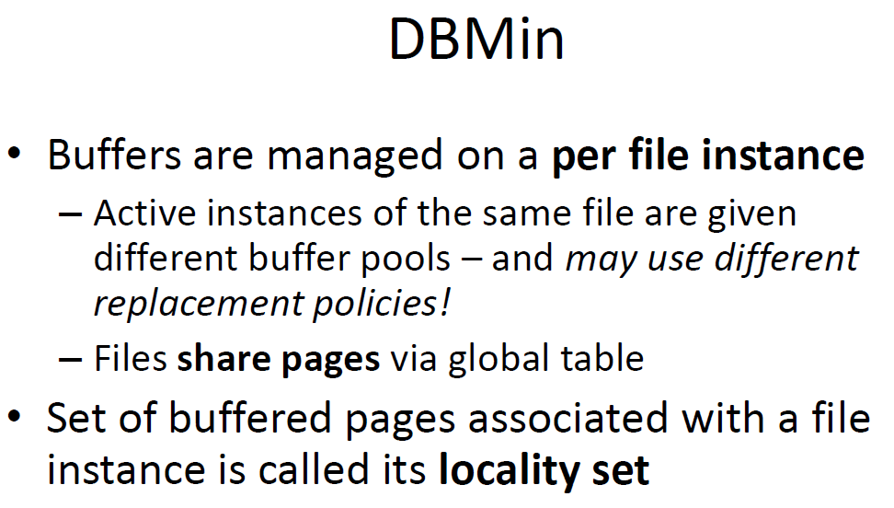
DBMS-Specific Buffer Replacement Policies (cont’d.)

Slide 11
Desirable Properties of Transactions
ACID properties
Atomicity
Transaction performed in its entirety or not at all
Consistency preservation
Takes database from one consistent state to another
Isolation
Not interfered with by other transactions
Durability or permanency
Changes must persist in the database

Slide 12
Desirable Properties of Transactions (cont’d.)
Levels of isolation
Level 0 isolation does not overwrite the dirty reads of higher-level transactions
Level 1 isolation has no lost updates
Level 2 isolation has no lost updates and no dirty reads
Level 3 (true) isolation has repeatable reads
In addition to level 2 properties
Snapshot isolation
transaction sees the data items that it reads based on the committed values of the items in the database snapshot (or database state) when the transaction starts. Snapshot isolation will ensure that the phantom record problem does not occur

Slide 13
Characterizing Schedules Based on Recoverability
Schedule or history
Order of execution of operations from all transactions
Operations from different transactions can be interleaved in the schedule
Total ordering of operations in a schedule
For any two operations in the schedule, one must occur before the other

Slide 14
Some Definitions
Schedule
A sequence of the operations by a set of concurrent transactions that preserves the order of the operations in each of the individual transactions.
Serial Schedule
A schedule where the operations of each transaction are executed consecutively without any interleaved operations from other transactions.
Non-serial Schedule
A schedule where the operations from a set of concurrent transactions are interleaved.

Slide 15
Serializablity
Serializability
Find non-serial schedules that allow transactions to execute concurrently without interfering with one another, and thereby produce a database state that could be produced by a serial execution.
If a set of transactions executes concurrently, We say that the (non-serial) schedule is correct
If it produces the same result as some serial execution.
Such a schedule is called serializable.
To prevent inconsistency from transactions interfering with one another… it is essential to guarantee serializability of concurrent transactions.

Slide 16
Characterizing Schedules Based on Recoverability (cont’d.)
Two conflicting operations in a schedule
Operations belong to different transactions
Operations access the same item X
At least one of the operations is a write_item(X)
Two operations conflict if changing their order results in a different outcome
Read-write conflict
Write-write conflict

Slide 17
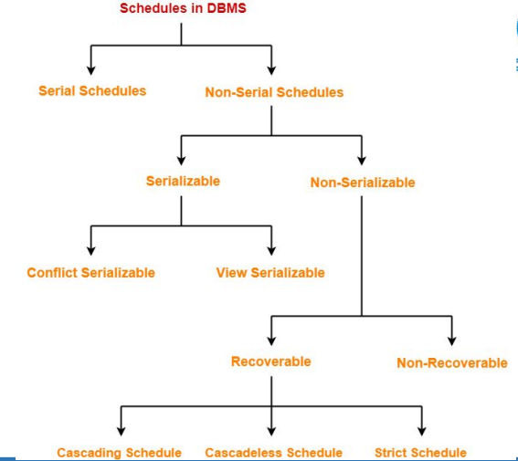

Slide 18
Characterizing Schedules Based on Recoverability (cont’d.)
Recoverable schedules
Recovery is possible
Nonrecoverable schedules should not be permitted by the DBMS
No committed transaction ever needs to be rolled back
Cascading rollback is a situation: where an uncommitted transaction has to be rolled back because it read an item from a transaction that failed.
Cascading rollback may occur in some recoverable schedules

Slide 19
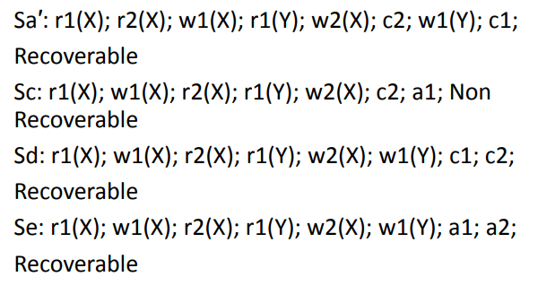
Example

